Slide 1
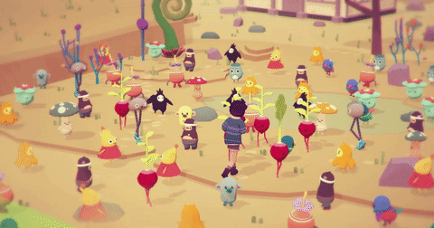
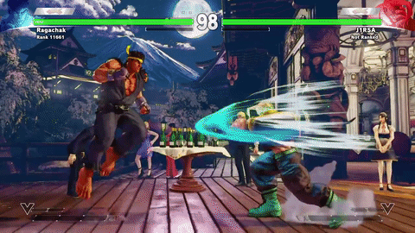
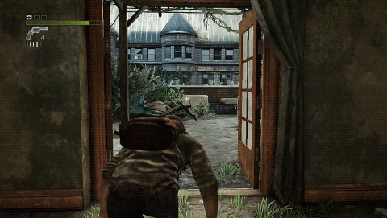
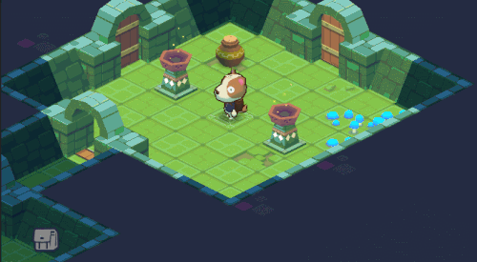
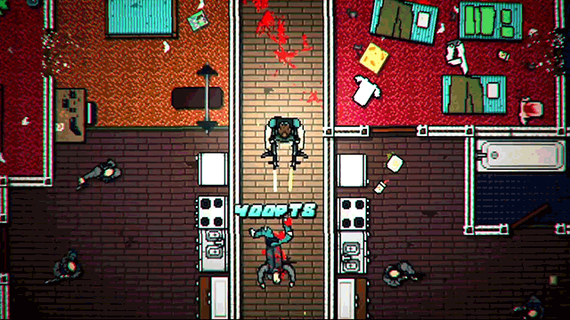
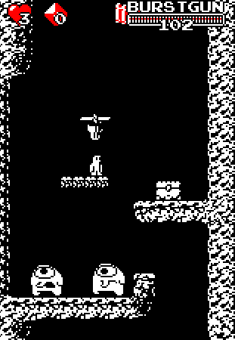
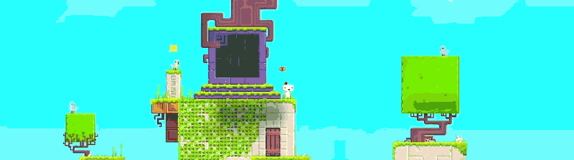
Welcome to GameDev0

Slide 2
Why we’re here
Notes:
Videogame development is extremely accessible today

Slide 3
Here's what u will learn
Art
Code
Sometimes the limit is your imagination
Modelling a world
Notes:
Basically games can be broken down into 2 parts
ART
-visuals
-sound
-writing
Yes I treat games as art so that’s how you know I'm serious
CODE
-game logic
The main thing is changing your perception of games. If you want to be successfully in gamedev then you have to shift your perspective to that of someone who plays game to someone creates games.
These two processes are similar but aren’t the same experience
Later we’ll get into what a game is

Slide 4
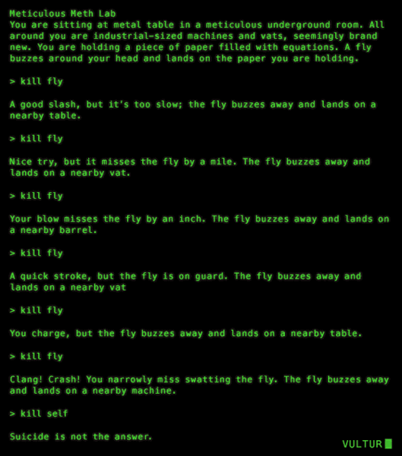

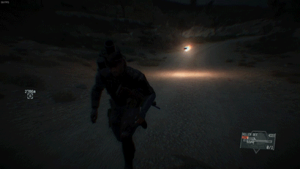
Visual Presentation
Notes:
Sometimes the mechanics inform the art style.
Sometimes your limitations inform the art style

Slide 5
Genre
Notes:
Fps
Moba
Platformer
Rpg
Hack and slash

Slide 6
Themes
Notes:
Some games don’t have strong themes are purely mechanical. Skill based games
Obfuscating control over the player to add a feeling of helplessness or disorientation
Good video games are built around a theme and have mechanics that are congruous
Blizzard themes overwatch characters to fit their mechanics

Slide 7
Code

Slide 8
Social media!!!!!!!!!!
Discord
Facebook page?

Slide 9
If(YouLikeGames || AreCreative){ society.join(“GameDev”); } else{ room.leave(); }
Notes:
Bonus how many 3D games?

